Slide 1
Mediator Pattern
Muhammad Usama
2021-SE-41

Slide 2
Mediator Pattern
Muhammad Usama
2021-SE-41

Slide 3
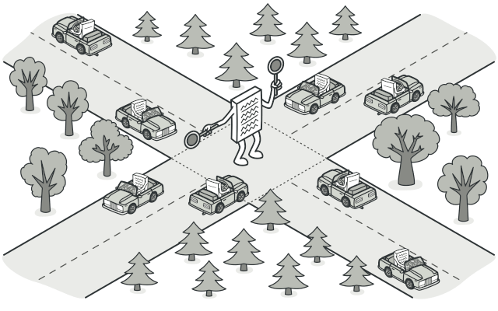
Mediator Pattern
The Mediator Pattern promotes loose coupling between objects by centralizing their interactions through a mediator object
It allows components to communicate without being directly connected to each other
Reducing dependencies and simplifying maintenance.

Slide 4
Pattern Type:
Behavioral
Why Behavioral?
Behavioral patterns focus on how objects collaborate and communicate with each other to achieve a certain goal, emphasizing the patterns of communication and responsibility

Slide 5
Usage:
When there are multiple interacting objects that require a centralized way to communicate.
To reduce dependencies: Objects don’t need to know the specifics of other objects, promoting a more maintainable and decoupled codebase.
To organize complex communication logic: It provides a centralized mediator to manage and control communication flow.

Slide 6
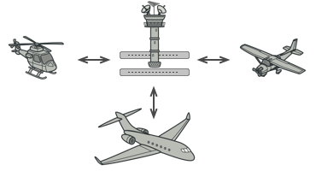
Real Life Example:
Aircraft pilots don’t talk to each other directly when deciding who gets to land their plane next. All communication goes through the control tower.

Slide 7
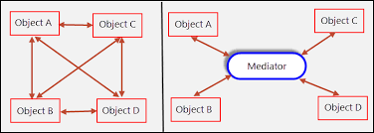
Diagram

